Slide 1
Preventing human trafficking through the power of analytics
Nhs r conference
November 2020
Sandro Matos

Slide 2

Agenda
Background
What R brings to the project
Data audit
Social listening
Text analytics
Digital analytics
Final summary

Slide 3
background

Slide 4

Hello!
Who I am
My name is Sandro Matos
I’m originally from Portugal
I’m a Senior Data Scientist
I have been working for Merkle Aquila for 3.5 years
I love travelling, eating and playing video games
Big Eurovision Song Contest lover
Huge fan of R

Slide 5







Merkle Aquila
Who we are
Established in 2012 and acquired by Merkle in 2017 we will be fully integrated as Merkle Analytics by end of 2020
Globally Merkle employ over 2500 data scientists and data engineers
Aquila has 130+ data analysts, scientists and data engineers
We create intelligent, appropriate analytical solutions to achieve our clients objectives and drive value.
We work with a vast range of clients from several different industries:

Slide 6






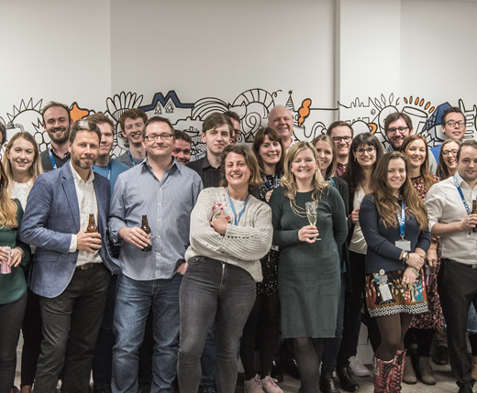
Skills sharing - From an idea to reality
The journey
Stop the Traffik (STT)
Global charity pioneering the cause of intelligence led prevention of human trafficking
Skills Sharing
Pro-bono initiative through which we share our expertise in analytics with charities
Giving Back Crowd
Internal initiative to promote giving back to the society, from fundraising to environmental responsibility
Merkle|Aquila
Data analytics company focused on extracting the maximum value from data, translating it into decisions which empower clients to take better actions
Analytics team
at Merkle|Aquila

Slide 7





Skills sharing - From an idea to reality
The journey
Jan 2018
Feb 2018
July 2018
March 2019
March 2020
‘Skills Based Volunteering’ was just an idea
We presented a plan for a Pilot to the Leadership Team
We explored different charities and identified STT as the right partner
A pilot commenced with the Research and Intelligence team at STT
Data audit and analysis
Social listening
Training
Partnership was extended
Comments categorisation
Reddit analysis
Power BI Support
Google Trends
Training
Partnership was extended until April 2021.
We’ve started working with STT Comms Team.

Slide 8

Human Trafficking and Slavery
still big problems
Slavery did not disappear when it was abolished two centuries ago, it was forced underground, in the shadows of our communities
The rise of the internet and technology have made it easy for traffickers to recruit and exploit
Human trafficking and modern slavery are thought to be amongst the most widespread crimes in the world
~24 million people trapped in forced labour via human trafficking worldwide – roughly the population of Australia
Human trafficking earns profits of roughly $150 billion a year – Nearly 4 times the revenue of Facebook (2018) and yet there were only 14,894 prosecutions and 9,071 convictions for trafficking globally (2016).
This Photo by Unknown Author is licensed under CC BY-SA

Slide 9

Stop the traffik
a pioneer in "Intelligence led" prevention
Works to combat human trafficking through intelligence-led prevention
If we understand how and where human trafficking is taking place, we can prevent it
We need an accurate and analysed global perspective, which can only happen with the coordinated gathering and sharing of data
WHO ARE THEY
Organize awareness courses for wide range of audiences (health, law, business, government, education)
Global supply-chain risk mapping for large companies who can unknowingly be implicated in trafficking
Work with on the ground partners on locally lead initiatives (financial institutions, law enforcement, government)
Organize tailored social media campaigns in areas believe may be trafficking to raise awareness
Collect global stories, connects them and builds a rich picture of human trafficking hotspots and trends
WHAT THEY DO

Slide 10

Why stop the traffik
The right partner for us
Stop the Traffik meets all our criteria:
Shares our ambition of leveraging data to address a pressing issue
Has data assets which enables us to add value
Did not have an existing inhouse Analytics team
Perfect way to use our free time as personal development while helping
a great cause!

Slide 11
What r brings to the project
Key workstreams

Slide 12





What r brings to the project
Key workstreams
Data Audit
Social Listening
Text Analytics
Digital Analytics
Human trafficking incident database
Data format fit for analysis
Exploratory Analysis
Real time data using Twitter and Reddit API
Follow specific topics
Engagement summary
Data visualisation
Facebook comments manually categorised
Automated way of categorising new data
Summary of general sentiment of comments
Setting up event tracking
Analysis of common search terms
Donation tracker
Support analysis of new campaigns
Find key journeys users follow on the website

Slide 13




Data audit
fit for analysis
Data
Data has been collected manually from online articles over the years
No standard analytical format was defined
Audit
Explore the available fields to find inconsistencies
Identify format issues
Cleaning
Keep the data consistent
Remove noise and duplicated information
Reformat the data to be fit for analysis
Automation
Keep the process automated and reproducible when new data becomes available
Keep the process flexible and easily adaptable if new data issues are found

Slide 14




Data audit
Cleansing process
Deduplication
Different entries for the same incident were deduped to keep the data consistent
Rules were applied to identify similar information
Lookup tables
Lookup tables were created in the code to group categories together
Functions were used to detect misspelling mistakes
Standardisation
Missing values and unknown information were standardised.
Standard field formats
Reformatting
Additional columns were created to be fit for analysis
Fields in a list format moved to multiple columns that would capture all their variance
This work and resulting recommendations on data collection have helped improve the accuracy of STT data and insights

Slide 15


Social listening
Data collection
Twitter analysis
twitteR package
rtweet package
Reddit analysis
Get access to a dataset of tweets through Twitter API
Follow tweets about a particular subject
Follow tweets including particular hashtags related to STT campaigns
Follow STT’s own twitter timeline to measure reach and engagement
Very popular online and seemed the most used one historically
It hasn’t been updated recently so it had some limitations
Tweets were truncated to 140 characters
Not as popular as twitteR so more difficult to find information
Very good online support and regular updates
Comprehensive set of variables
We’ve used the RedditExtractoR package to extract reddit posts including specific search terms:
Human trafficking
Stop the Traffik
Load data into Power BI for dashboarding – integration with R Scripts

Slide 16
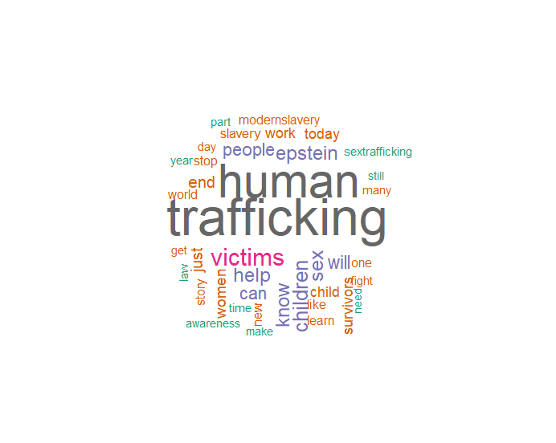


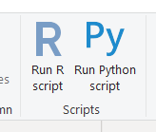
Social listening
outputs
Data visualisation
Use the available tweets to have an easy way to visualise what people are tweeting about
The package wordcloud was used to create a word cloud using the original tweets text
R Script used in Power BI to build Reddit dashboard
This work has enabled STT to better track trends in key words of interest on social media and will be part of a wider social listening tool (WIP)

Slide 17


Text analytics
Supervised learning
Data
Data prep
Modelling
Comments manually pulled from STT posts
Comments were manually categorised into different sentiment categories
We aim to categorise new comments automatically through machine learning
Feature engineering
General text characteristics
Writing style
Package tm was used to clean the data
Remove stop words
Keep alphanumeric characters only
Words stemming
Identify key words
Logistic regression models were built to predict every category
New data is categorised using these models
Each comment gets attributed the category with highest probability
Highlights general sentiment of comments
This work provides a quick way of measuring campaign effectiveness and can be used for different text categorisation problems

Slide 18




Digital analytics
Using google analytics data
Event tracking
Get insights on specific events such as:
Scrolling through the pages
Search terms
Outbound links
Donation tracker
Track donations on the website over time
Build metrics such as: donations per visitor and average donated amount
Campaign analysis
Getting data from new landing pages created for awareness campaigns
Insights on what type of audience access the pages
Key web journeys
Understand what are the key journeys the users follow on website
Find what can be changed to help users find what they need
This work is helping STT getting the most insights about their website users to improve future content and features

Slide 19
Final summary
Why r?

Slide 20

Final summary
Why r?
This is a pro-bono initiative, having a powerful analytical tool available for free makes R a great choice
R has the flexibility we needed for complex analysis from using APIs to text mining
It’s easy to adapt our R program and replicate it for similar problems
Straightforward handover of scripts
This Photo by Unknown Author is licensed under CC BY-NC-ND

Slide 21
Thank you https://www.merkleinc.com/emea/what-we-do/analytics https://www.stopthetraffik.org/

